Slide 1
Sexually transmitted infections

Slide 2
Sexually transmitted infections (STIs) are a group of contagious conditions whose principal mode of transmission is by intimate sexual activity involving the moist mucous membranes of the penis, vulva, vagina, cervix, anus, rectum, mouth and pharynx, along with their adjacent skin surfaces.

Slide 3
A wide range of infections may be sexually transmitted, including syphilis, gonorrhoea, human immunodeficiency virus (HIV), genital herpes, genital warts, chlamydia and trichomoniasis.

Slide 4
Bacterial vaginosis and genital candidiasis are not regarded as STIs, although they are common causes of vaginal discharge in sexually active women.
Chancroid, lymphogranuloma venereum and granuloma inguinale are usually seen in tropical countries.
Hepatitis viruses A, B, C and D may be acquired sexually, as well as by other routes.

Slide 5
The World Health Organization estimates that 340 million curable STIs occur each year, including 170 million cases of Trichomonas vaginalis, 92 million cases of Chlamydia trachomatis, 62 million cases of gonorrhoea and 12 million cases of syphilis.

Slide 6
In the UK in 2007, the most common treatable STIs diagnosed were chlamydia (more than 120000 cases) and gonorrhoea (18000 cases). Genital warts are the second most common complaint seen in genitourinary medicine (GUM) departments.

Slide 7
As coincident infection with more than one STI is frequently seen, GUM clinics routinely offer a full set of investigations at the patient’s first visit, regardless of the reason for attendance. In other settings, less comprehensive investigation may be appropriate.

Slide 8
The extent of the examination largely reflects the likelihood of HIV infection or syphilis.
Most heterosexuals in the UK are at such low risk of these infections that routine extragenital examination is unnecessary. This is not the case in parts of the world where HIV is endemic, or for men who have sex with men (MSM) in the UK. In other words, the extent of the examination is determined by the sexual history.

Slide 9
APPROACH TO PATIENTS WITH A SUSPECTED STI:
Patients concerned about the possible acquisition of an STI are often anxious. Staff must be friendly, sympathetic and reassuring; they should have the ability to put patients at ease, whilst emphasising that clinic attendance is confidential.

Slide 10
The history focuses on genital symptoms, with reference to genital ulceration, rash, irritation, pain, swelling and urinary symptoms, especially dysuria.
In men, the clinician should ask about urethral discharge, and in women, vaginal discharge, pelvic pain or dyspareunia.

Slide 11
Enquiry about general health should include menstrual and obstetric history, cervical cytology, recent medication, especially with antimicrobial or antiviral agents, previous STI and allergy.
Immunisation status for hepatitis A and B should be noted, as should information about recreational drug use.

Slide 12
A detailed sexual history is imperative, as this informs the clinician of the degree of risk for certain infections as well as specific sites that should be sampled; for example, rectal samples should be taken from men who have had unprotected anal sex with other men.

Slide 13
Sexual partners, whether male or female, and casual or regular, should be recorded. Sexual practices—insertive or receptive vaginal, anal, orogenital or oroanal—should be noted. Choice of contraception should be recorded for women, together with condom use for both sexes.

Slide 14
STI in children:
The presence of an STI in a child may be indicative of sexual abuse, although vertical transmission may explain some presentations in the first 2 years.
In an older child, STI may be the result of voluntary sexual activity.

Slide 15
STI during pregnancy:
Many STIs can be transmitted from mother to child in pregnancy, either transplacentally or during delivery.

Slide 16
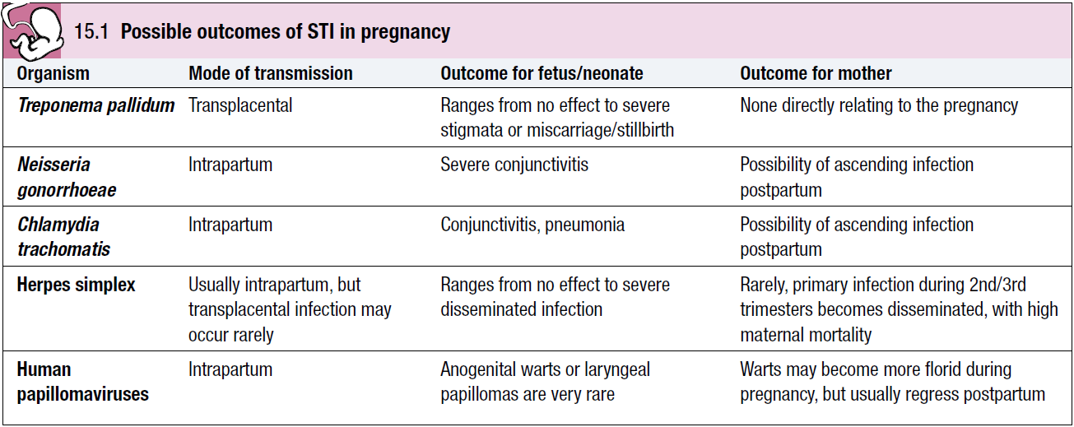

Slide 17
PRESENTING PROBLEMS IN MEN:
Urethral discharge:
In the UK the most important causes of urethral discharge are gonorrhoea and chlamydia.

Slide 18
In a significant minority of cases, tests for both of these infections are negative, a scenario often referred to as non-specific urethritis (NSU).
Some of these cases may be caused by Trichomonas vaginalis, herpes simplex virus (HSV), mycoplasmas or ureaplasmas.
A small minority seem not to have an infectious aetiology.

Slide 19
Gonococcal urethritis usually causes symptoms within 7 days of exposure. The discharge is typically profuse and purulent.
Chlamydial urethritis has an incubation period of 1–4 weeks, and tends to result in milder symptoms than gonorrhoea; there is overlap, however, and microbiological confirmation should always be sought.

Slide 20
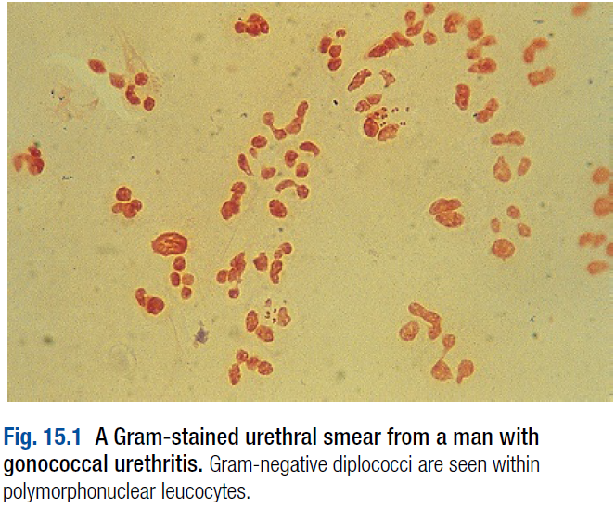
Investigations:
A presumptive diagnosis of urethritis can be made from a Gram-stained smear of the urethral exudate, which will demonstrate significant numbers of polymorphonuclear leucocytes (≥ 5 per high-power field).

Slide 21
A working diagnosis of gonococcal urethritis is made if Gram-negative intracellular diplococci (GNDC) are seen; if no GNDC are seen, a label of non-specific urethritis is applied.
If microscopy is not available, swabs and/or urine samples should be taken and empirical antimicrobials prescribed.

Slide 22
A urethral swab should always be sent for culture of Neisseria gonorrhoeae; in addition, a first void urine (FVU) sample or a specific urethral swab should be sent for detection of chlamydial DNA by a nucleic acid amplification test (NAAT) such as polymerase chain reaction (PCR).
NAATs are likely to replace the need for routine culture for gonorrhoea.
Tests for other potential causes of urethritis are not performed routinely.

Slide 23
A swab should also be taken from the pharynx because gonococcal infection at this site is not reliably eradicated by single-dose therapy.
In MSM swabs for gonorrhoea and chlamydia should be taken from the rectum.

Slide 24
Management:
This depends upon local epidemiology and the availability of diagnostic resources.
Treatment is often presumptive, with prescription of multiple antimicrobials to cover the possibility of gonorrhoea and/or chlamydia.
This is likely to include a single-dose treatment for gonorrhoea, which is desirable because it eliminates the risk of non-adherence.

Slide 25
The recommended agents for treating gonorrhoea vary according to local antimicrobial resistance patterns.
Appropriate treatment for chlamydia should also be prescribed because concurrent infection is present in up to 50% of men with gonorrhoea.
Non-gonococcal, non-chlamydial urethritis is treated as for chlamydia.

Slide 26
Patients should be advised to avoid sexual contact until it is confirmed that any infection has resolved, and whenever possible, recent sexual contacts should be traced.
The task of contact tracing—also called partner notification—is best performed by trained nurses based in GUM clinics; it is standard practice in the UK to treat current sexual partners of men with gonococcal or non-specific urethritis without waiting for microbiological confirmation.

Slide 27
If symptoms clear, a routine test of cure is not necessary, but patients should be re-interviewed to confirm that there was no immediate vomiting or diarrhoea after treatment, that there has been no risk of re-infection, and that traceable partners have sought medical advice.

Slide 28
Genital itch and/or rash:
Patients may present with many combinations of penile/genital symptoms that may be acute or chronic, and infectious or non-infectious.

Slide 29
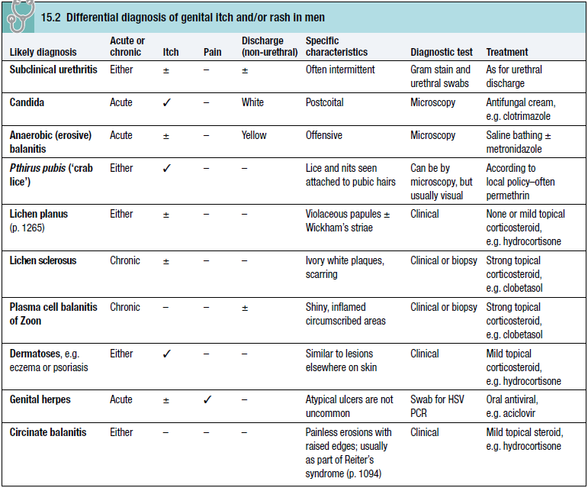

Slide 30
Balanitis refers to inflammation of the glans penis, often extending to the under-surface of the prepuce when it is called balanoposthitis. Tight prepuce and poor hygiene may be aggravating factors.

Slide 31
Candidiasis is sometimes associated with immune deficiency, diabetes mellitus, and the use of broad-spectrum antimicrobials, corticosteroids or antimitotic drugs. Local saline bathing is usually helpful, especially when no cause is found.

Slide 32
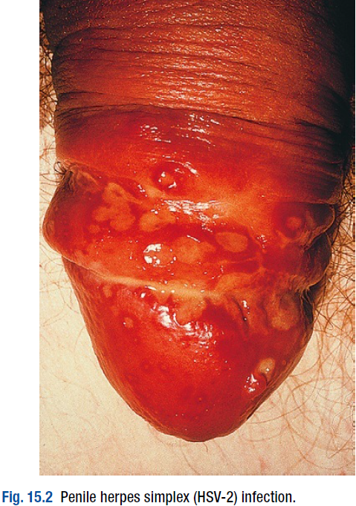
Genital ulceration:
The most common cause of ulceration is genital herpes.
Classically, multiple painful ulcers affect the glans, coronal sulcus or shaft of penis, but solitary lesions occur rarely.

Slide 33
Perianal ulcers may be seen in MSM.
The diagnosis is made by gently scraping material from lesions and sending this in an appropriate transport medium for culture or detection of HSV DNA by PCR.
In the UK, the possibility of any other ulcerating STI is remote unless the patient is an MSM and/or has had a sexual partner from a region where tropical STIs are more common.

Slide 34
The classic lesion of primary syphilis (chancre) is single, painless and indurated; however, multiple lesions are seen rarely and anal chancres are often painful.
Diagnosis is made in GUM clinics by dark-ground microscopy, but in other settings by serological tests for syphilis.

Slide 35
Other rare infective causes seen in the UK include varicella zoster virus and trauma with secondary infection.
Tropical STI include chancroid, lymphogranuloma venereum (LGV) and granuloma inguinale.

Slide 36
Inflammatory causes include Stevens–Johnson syndrome, Behçet’s syndrome and fixed drug reactions.
In older patients, malignant and pre-malignant conditions such as squamous cell carcinoma and erythroplasia of Queyrat (intra-epidermal carcinoma) should be considered.

Slide 37
Genital lumps:
The most common cause of genital ‘lumps’ is warts. These are classically found in areas of friction during sex such as the parafrenal skin and prepuce of the penis.
Warts may also be seen in the urethral meatus, and less commonly on the shaft or around the base of the penis.
Perianal warts are surprisingly common in men who do not have anal sex.

Slide 38
The differential diagnosis includes molluscum contagiosum and skin tags.
Adolescent boys may confuse normal anatomical features such as coronal papillae, parafrenal glands or sebaceous glands (Fordyce spots) with warts.

Slide 39
Proctitis in men who have sex with men:
STIs that may cause proctitis in MSM include gonorrhoea, chlamydia, herpes and syphilis.
The substrains of Chlamydia trachomatis that cause LGV (L1–3) have been associated with outbreaks of severe proctitis in the Netherlands and the UK.
Symptoms include mucopurulent anal discharge, rectal bleeding, pain and tenesmus.

Slide 40
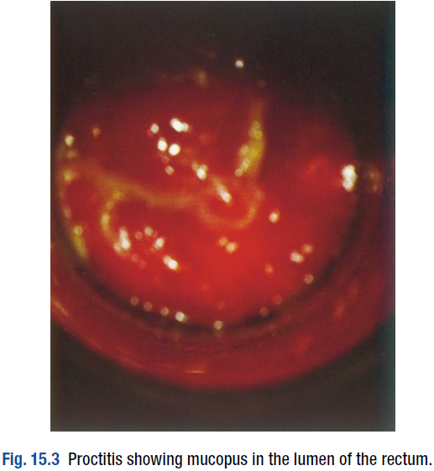
Examination may show mucopus and erythema with contact bleeding.

Slide 41
In addition to other diagnostic tests, a PCR test for HSV and a request for identification of LGV substrain should be arranged if chlamydial infection is detected.
Treatment is directed at the individual infections.
MSM may also present with gastrointestinal symptoms from infection with organisms such as Entamoeba histolytica, Shigella spp., Campylobacter spp. and Cryptosporidium spp.

Slide 42
PRESENTING PROBLEMS IN WOMEN:
Vaginal discharge:
The natural vaginal discharge may vary considerably, especially under differing hormonal influences such as puberty, pregnancy or prescribed contraception.

Slide 43
A sudden or recent change in discharge, especially if associated with alteration of colour and/or smell, or vulval itch/irritation is more likely to indicate an infective cause than a gradual or long-standing change.

Slide 44
Local epidemiology is particularly important when assessing possible causes.
In the UK, most cases of vaginal discharge are not sexually transmitted, being due to either candidal infection or bacterial vaginosis (BV).
World-wide, the most common treatable STI causing vaginal discharge is trichomoniasis; other possibilities include gonorrhoea and chlamydia.

Slide 45
HSV may cause increased discharge, although vulval pain and dysuria are usually the predominant symptoms.
Non-infective causes include retained tampons, malignancy and/or fistulae.
Speculum examination often allows a relatively accurate diagnosis to be made.

Slide 46
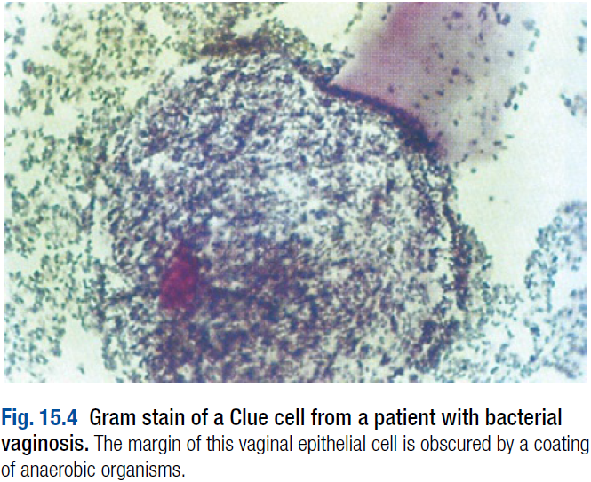
In BV, the discharge is characteristically homogeneous and off-white in colour.
Vaginal pH is greater than 4.5, and Gram stain microscopy reveals scanty or absent lactobacilli with significant numbers of Gram-variable organisms, some of which may be coating vaginal squames (so-called Clue cells).

Slide 47
In candidiasis, there may be vulval and vaginal erythema, and the discharge is typically curdy in nature.
Vaginal pH is usually less than 4.5, and Gram stain microscopy reveals fungal spores and pseudohyphae.
Trichomoniasis tends to cause a profuse yellow or green discharge and is usually associated with significant vulvovaginal inflammation.
Diagnosis is made by observing motile flagellate protozoa on a wet-mount microscopy slide of vaginal material.

Slide 48
If examination reveals the discharge to be cervical in origin, the possibility of chlamydial or gonococcal infection is increased and appropriate cervical swabs should be taken.

Slide 49
In addition, Gram stain of cervical and urethral material may reveal GNDC, allowing presumptive treatment for gonorrhoea to be given.
If gonococcal cervicitis is suspected, swabs should also be taken from the pharynx and rectum; infections at these sites are not reliably eradicated by single-dose therapy and a test of cure will therefore be required.

Slide 50
GUM clinics in the UK routinely offer sexually active women presenting with vaginal discharge an STI screen.
In other settings such as primary care or gynaecology, testing for chlamydia and gonorrhoea should be strongly considered in young women (< 25 years old), those who have changed partner recently, and those not using a barrier method of contraception, even if a non- STI cause of discharge is suspected clinically.

Slide 51
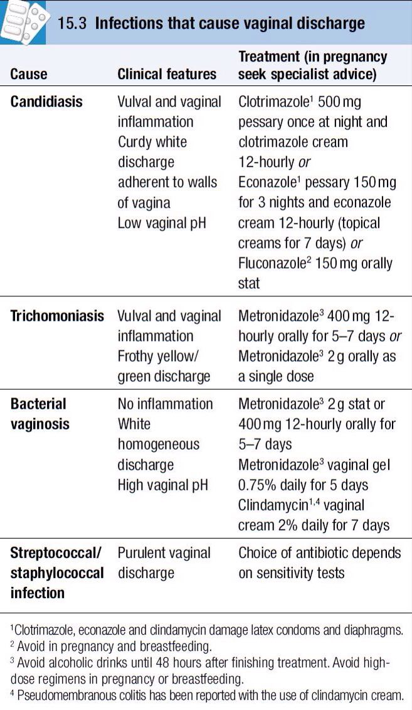

Slide 52
Lower abdominal pain:
Pelvic inflammatory disease (PID, infection or inflammation of the Fallopian tubes and surrounding structures) is part of the extensive differential diagnosis of lower abdominal pain in women, especially those who are sexually active.
The possibility of PID is increased if, in addition to acute/subacute pain, there is dyspareunia, abnormal vaginal discharge and/or bleeding.

Slide 53
There may also be systemic features such as fever and malaise.
On examination, lower abdominal pain is usually bilateral, and vaginal examination reveals adnexal tenderness with or without cervical excitation.
Unfortunately, a definitive diagnosis can only be made by laparoscopy.

Slide 54
A pregnancy test should be performed (in addition to other diagnostic tests) because the differential diagnosis includes ectopic pregnancy.

Slide 55
Broad-spectrum antibiotics, including those active against gonorrhoea and chlamydia such as ofloxacin and metronidazole, should be prescribed if PID is suspected, along with appropriate analgesia.
Delaying treatment increases the likelihood of adverse sequelae such as abscess formation, and tubal scarring that may lead to ectopic pregnancy or infertility.
Hospital admission may be indicated in women with severe symptoms.

Slide 56
Genital ulceration:
The most common cause of ulceration is genital herpes.
Classically, multiple painful ulcers affect the introitus, labia and perineum, but solitary lesions occur rarely.
Inguinal lymphadenopathy and systemic features such as fever and malaise are more common than in men.

Slide 57
Diagnosis is made by gently scraping material from lesions and sending this in an appropriate transport medium for culture or detection of HSV DNA by PCR.
In the UK, the possibility of any other ulcerating STI is unlikely unless the patient has had a sexual partner from a region where tropical STIs are more common.

Slide 58
Inflammatory causes include lichen sclerosus, Stevens–Johnson syndrome, Behçet’s syndrome and fixed drug reactions.
In older patients, malignant and pre-malignant conditions such as squamous cell carcinoma should be considered.

Slide 59
Genital lumps:
The most common cause of genital ‘lumps’ is warts. These are classically found in areas of friction during sex, such as the fourchette and perineum.
Perianal warts are surprisingly common in women who do not have anal sex.
The differential diagnosis includes molluscum contagiosum, skin tags and normal papillae or sebaceous glands.

Slide 60
Chronic vulval pain and/or itch:
Women may present with a range of chronic symptoms that may be intermittent or continuous.

Slide 61
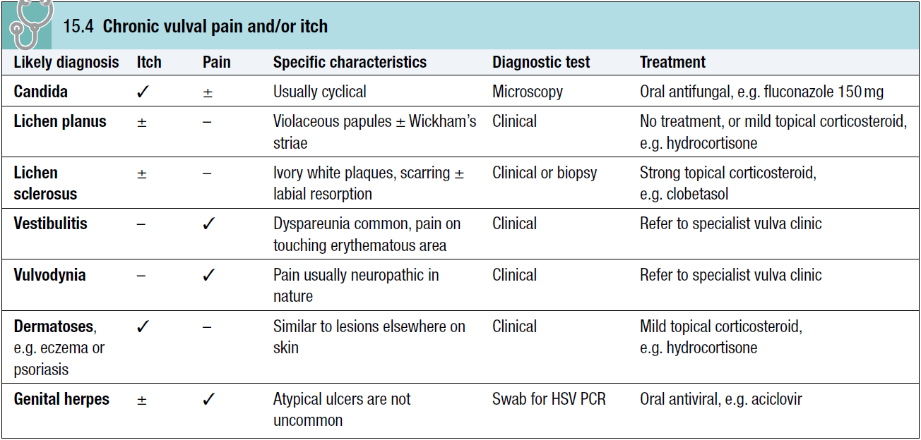

Slide 62
Recurrent candidiasis may lead to hypersensitivity to candidal antigens, with itch and erythema becoming more prominent than increased discharge.
Effective treatment may require regular oral antifungals, e.g. fluconazole 150 g once every 2–4 weeks plus a combined antifungal/corticosteroid cream such as Daktacort or Canesten HC.

Slide 63
PREVENTION OF STI:
Case-finding:
Early diagnosis and treatment facilitated by active case-finding will help to reduce the spread of infection by limiting the period of infectivity; tracing and treating sexual partners will also reduce the risk of re-infection.

Slide 64
Unfortunately, the majority of individuals with an STI are asymptomatic and therefore unlikely to seek medical attention.
Improving access to diagnosis in primary care or non-medical settings, especially through opportunistic testing, may help.
However, the impact of medical intervention through improved access alone is likely to be small.

Slide 65
Changing behaviour:
The prevalence of STIs is driven largely by sexual behaviour.
Primary prevention encompasses efforts to delay the onset of sexual activity and limit the number of sexual partners thereafter.
Encouraging the use of barrier methods of contraception will also help to reduce the risk of transmitting or acquiring STIs. This is especially important in the setting of ‘sexual concurrency’, where sexual relationships overlap.

Slide 66
Unfortunately, there is contradictory evidence as to which (if any) interventions can reduce sexual activity.
Knowledge alone does not translate into behaviour change, and broader issues such as poor parental role modelling, low self-esteem, peer group pressure in the context of the increased sexualisation of our societies, gender power imbalance and homophobia all need to be addressed.

Slide 67
Throughout the world there is a critical need to enable women to protect themselves from indisciplined and coercive male sexual activity.
Economic collapse and the turmoil of war regularly lead to situations where women are raped or must turn to prostitution to feed themselves and their children, and an inability to negotiate safe sex increases their risk of acquiring STI, including HIV.

Slide 68
SEXUALLY TRANSMITTED BACTERIAL INFECTIONS:
Syphilis:
Syphilis is caused by infection, through abrasions in the skin or mucous membranes, with the spirochaete Treponema pallidum.
In adults the infection is usually sexually acquired; however, transmission by kissing, blood transfusion and percutaneous injury has been reported.
Transplacental infection of the fetus can occur.

Slide 69
The natural history of untreated syphilis is variable.
Infection may remain latent throughout, or clinical features may develop at any time.
All infected patients should be treated.
Penicillin remains the drug of choice for all stages of infection.

Slide 70
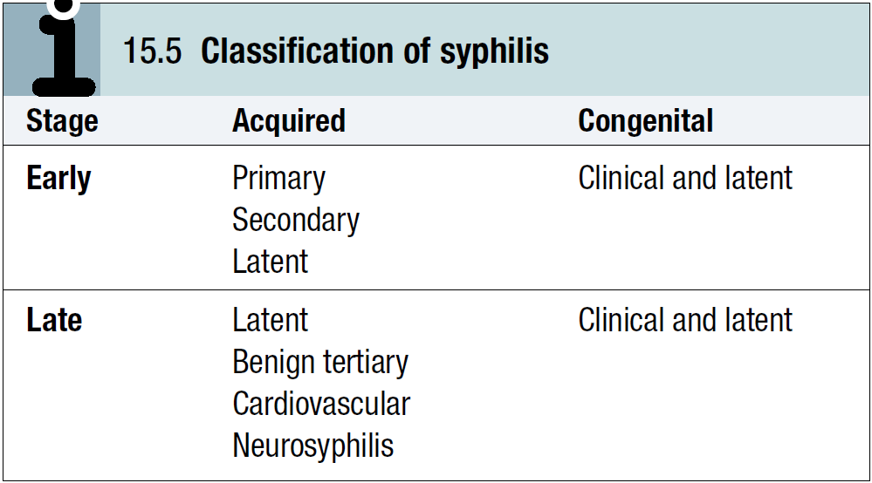

Slide 71
Acquired syphilis:
Early syphilis:
a. Primary syphilis:
The incubation period is usually between 14 and 28 days with a range of 9–90 days.

Slide 72
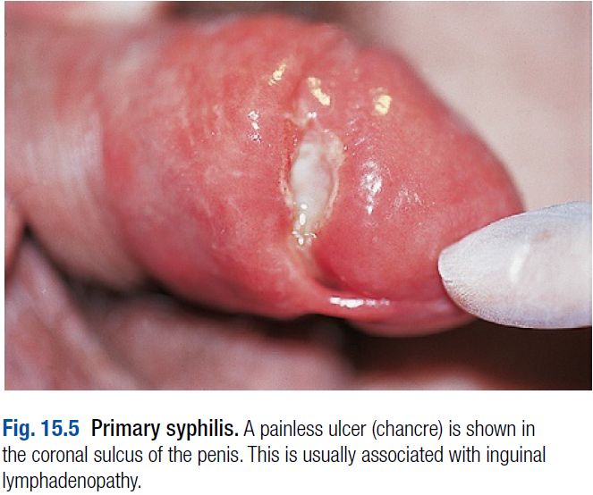
The primary lesion or chancre develops at the site of infection, usually in the genital area.

Slide 73
A dull red macule develops, becomes papular and then erodes to form an indurated ulcer (chancre).
The draining inguinal lymph nodes may become moderately enlarged, mobile, discrete and rubbery.
The chancre and the lymph nodes are both painless and non-tender, unless there is concurrent or secondary infection.
Without treatment, the chancre will resolve within 2–6 weeks to leave a thin atrophic scar.

Slide 74
Chancres may develop on the vaginal wall and on the cervix.
Extragenital chancres are found in about 10% of patients, affecting sites such as the finger, lip, tongue, tonsil, nipple, anus or rectum.
Anal chancres often resemble fissures and may be painful.

Slide 75
b. Secondary syphilis:
This occurs 6–8 weeks after the development of the chancre when treponemes disseminate to produce a multisystem disease.
Constitutional features such as mild fever, malaise and headache are common.

Slide 76
Over 75% of patients present with a rash on the trunk and limbs that may later involve the palms and soles; this is initially macular but evolves to maculopapular or papular forms, which are generalised, symmetrical and non-irritable.
Scales may form on the papules later.
Without treatment, the rash may last for up to 12 weeks.

Slide 77
Condylomata lata (papules coalescing to plaques) may develop in warm, moist sites such as the vulva or perianal area.
Generalised non-tender lymphadenopathy is present in over 50% of patients.
Mucosal lesions, known as mucous patches, may affect the genitalia, mouth, pharynx or larynx and are essentially modified papules, which become eroded.
Rarely, confluence produces characteristic ‘snail track ulcers’ in the mouth.

Slide 78
Other features such as meningitis, cranial nerve palsies, anterior or posterior uveitis, hepatitis, gastritis, glomerulonephritis or periostitis are sometimes seen.
The differential diagnosis of secondary syphilis can be extensive, but in the context of a suspected STI, primary HIV infection is the most important alternative condition to consider.

Slide 79
The clinical manifestations of secondary syphilis will resolve without treatment but relapse may occur, usually within the first year of infection. Thereafter, the disease enters the phase of latency.

Slide 80
c. Latent syphilis:
This phase is characterised by the presence of positive syphilis serology or the diagnostic cerebrospinal fluid (CSF) abnormalities of neurosyphilis in an untreated patient with no evidence of clinical disease.
It is divided into early latency (within 2 years of infection), when syphilis may be transmitted sexually, and late latency, when the patient is no longer sexually infectious.
Transmission of syphilis from a pregnant woman to her fetus, and rarely by blood transfusion, is possible for several years following infection.

Slide 81
Late syphilis:
a. Late latent syphilis:
This may persist for many years or for life.
Without treatment over 60% of patients might be expected to suffer little or no ill health.
Coincidental prescription of antibiotics for other illnesses such as respiratory tract or skin infections may treat latent syphilis serendipitously.

Slide 82
b. Benign tertiary syphilis:
This may develop between 3 and 10 years after infection but is now rarely seen in the UK.
Skin, mucous membranes, bone, muscle or viscera can be involved.
The characteristic feature is a chronic granulomatous lesion called a gumma, which may be single or multiple.
Healing with scar formation may impair the function of the structure affected.

Slide 83
Skin lesions may take the form of nodules or ulcers whilst subcutaneous lesions may ulcerate with a gummy discharge.
Healing occurs slowly with the formation of characteristic tissue paper scars.
Mucosal lesions may occur in the mouth, pharynx, larynx or nasal septum, appearing as punched-out ulcers.

Slide 84
Of particular importance is gummatous involvement of the tongue, healing of which may lead to leucoplakia with the attendant risk of malignant change.
Gummas of the tibia, skull, clavicle and sternum have been described, as has involvement of the brain, spinal cord, liver, testis and, rarely, other organs.

Slide 85
Resolution of active disease should follow treatment, though some tissue damage may be permanent.
Paroxysmal cold haemoglobinuria may be seen.

Slide 86
c. Cardiovascular syphilis:
This may present many years after initial infection.
Aortitis which may involve the aortic valve and/or the coronary ostia is the key feature.
Clinical features include aortic incompetence, angina and aortic aneurysm.

Slide 87
The condition typically affects the ascending aorta and sometimes the aortic arch; aneurysm of the descending aorta is rare.
Treatment with penicillin will not correct anatomical damage and surgical intervention may be required.

Slide 88
d. Neurosyphilis:
This may also take years to develop.
Asymptomatic infection is associated with CSF abnormalities in the absence of clinical signs.
Meningovascular disease, tabes dorsalis and general paralysis of the insane constitute the symptomatic forms.
Neurosyphilis and cardiovascular syphilis may coexist and are sometimes referred to as quaternary syphilis.

Slide 89
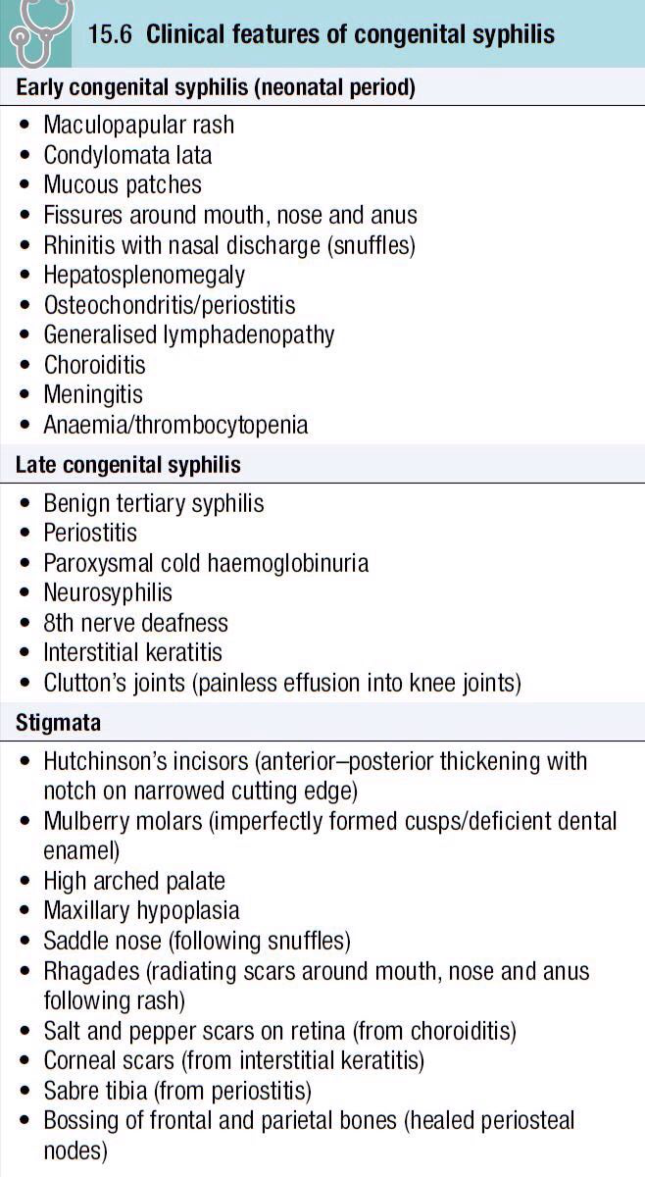
Congenital syphilis:
Congenital syphilis is rare where antenatal serological screening is practised.
Antisyphilitic treatment in pregnancy treats the fetus, if infected, as well as the mother.

Slide 90
Treponemal infection may give rise to a variety of outcomes after 4 months of gestation when the fetus becomes immunocompetent:
miscarriage or stillbirth, premature or at term
birth of a syphilitic baby (a very sick baby with hepatosplenomegaly, bullous rash and perhaps pneumonia)
birth of a baby who develops signs of early congenital syphilis during the first few weeks of life
birth of a baby with latent infection who either remains well or develops congenital syphilis/stigmata later in life.

Slide 91
Investigations in adult cases:
T. pallidum may be identified in serum collected from chancres, or from moist or eroded lesions in secondary syphilis using a dark-field microscope, a direct fluorescent antibody test or PCR.

Slide 92
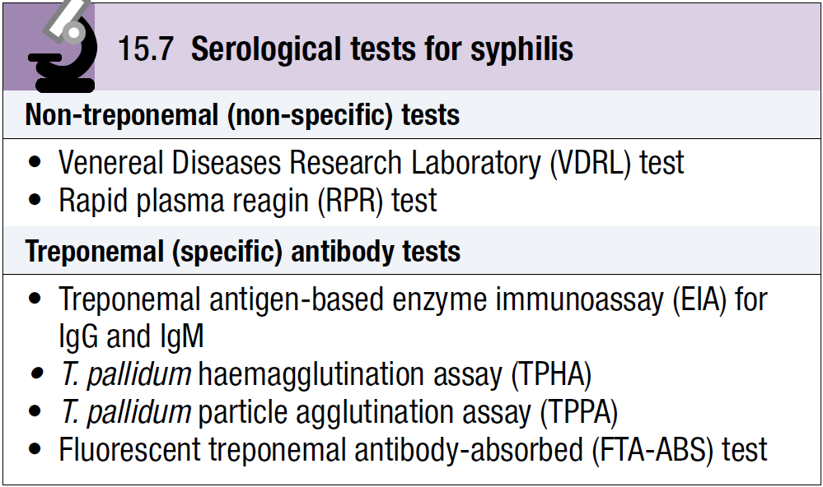

Slide 93
Many centres use treponemal enzyme immunoassays (EIAs) for IgG and IgM antibodies to screen for syphilis.
EIA for antitreponemal IgM becomes positive at approximately 2 weeks, whilst non-treponemal tests become positive about 4 weeks after primary syphilis.
All positive results in asymptomatic patients must be confirmed by repeat tests.

Slide 94
Biological false positive reactions occur occasionally; these are most commonly seen with Venereal Diseases Research Laboratory (VDRL) or rapid plasma reagin (RPR) tests (when treponemal tests will be negative).
Acute false positive reactions may be associated with infections such as infectious mononucleosis, chickenpox and malaria, and may also occur in pregnancy.

Slide 95
Chronic false positive reactions may be associated with autoimmune diseases.
False negative results for non-treponemal tests may be found in secondary syphilis because extremely high antibody levels can prevent the formation of the antibody–antigen lattice necessary for the visualisation of the flocculation reaction (the prozone phenomenon).

Slide 96
In benign tertiary and cardiovascular syphilis, examination of CSF should be considered because asymptomatic neurological disease may coexist.
The CSF should also be examined in patients with clinical signs of neurosyphilis and in both early and late congenital syphilis.
Chest X-ray, ECG and echocardiogram are useful in the investigation of cardiovascular syphilis.
Biopsy may be required to diagnose gumma.

Slide 97
Endemic treponematoses such as yaws, endemic (non-venereal) syphilis (bejel) and pinta are caused by treponemes morphologically indistinguishable from T. pallidum that cannot be differentiated by serological tests.
A VDRL or RPR test may help to elucidate the correct diagnosis because adults with late yaws usually have low titres.

Slide 98
Investigations in suspected congenital syphilis:
Passively transferred maternal antibodies from an adequately treated mother may give rise to positive serological tests in her baby.
In this situation, non-treponemal tests should become negative within 3–6 months of birth.
A positive EIA test for antitreponemal IgM suggests early congenital syphilis.
A diagnosis of congenital syphilis mandates investigation of the mother, her partner and any siblings.

Slide 99
Management:
Penicillin is the drug of choice.
Specific regimens depend on the stage of infection.
Longer courses are required in late syphilis.
Doxycycline is indicated for patients allergic to penicillin, except in pregnancy. Azithromycin is a further alternative.
All patients must be followed up to ensure cure, and partner notification is of particular importance.

Slide 100
Resolution of clinical signs in early syphilis with declining titres for non-treponemal tests, usually to undetectable levels within 6 months for primary syphilis and 12–18 months for secondary syphilis, are indicators of successful treatment.
Specific treponemal antibody tests may remain positive for life.
In patients who have had syphilis for many years there may be little serological response following treatment.

Slide 101
Pregnancy:
Penicillin is the treatment of choice in pregnancy.
Erythromycin stearate can be given if there is penicillin hypersensitivity, but crosses the placenta poorly; the newborn baby must therefore be treated with a course of penicillin and consideration given to retreating the mother.

Slide 102
Some specialists recommend penicillin desensitisation for pregnant mothers so that penicillin can be given during temporary tolerance. The author has successfully prescribed ceftriaxone 250 mg i.m. for 10 days in this situation.
Babies should be treated in hospital with the help of a pediatrician.

Slide 103
Treatment reactions:
a. Anaphylaxis: Penicillin is a common cause; on-site facilities should be available for management.
b. Jarisch–Herxheimer reaction: This is an acute febrile reaction that follows treatment and is characterised by headache, malaise and myalgia; it resolves within 24 hours. It is common in early syphilis and rare in late syphilis.

Slide 104
Fetal distress or premature labour can occur in pregnancy. The reaction may also cause worsening of neurological (cerebral artery occlusion) or ophthalmic (uveitis, optic neuritis) disease, myocardial ischaemia (inflammation of the coronary ostia) and laryngeal stenosis (swelling of a gumma).

Slide 105
Prednisolone 10–20 mg orally 8-hourly for 3 days is recommended to prevent the reaction in patients with these forms of the disease; antisyphilitic treatment can be started 24 hours after introducing corticosteroids. In high-risk situations it is wise to initiate therapy in hospital.

Slide 106
c. Procaine reaction: Fear of impending death occurs immediately after the accidental intravenous injection of procaine penicillin and may be associated with hallucinations or fits. Symptoms are short-lived, but verbal assurance and sometimes physical restraint are needed. The reaction can be prevented by aspiration before intramuscular injection to ensure the needle is not in a blood vessel.

Slide 107
Gonorrhoea:
Gonorrhoea is caused by infection with Neisseria gonorrhoeae and may involve columnar epithelium in the lower genital tract, rectum, pharynx and eyes.
Transmission is usually the result of vaginal, anal or oral sex.
Gonococcal conjunctivitis may be the result of accidental infection from contaminated fingers.

Slide 108
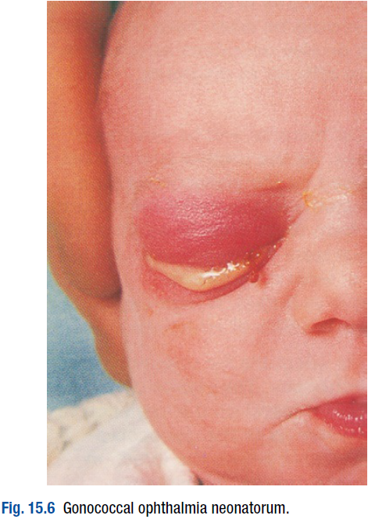
Untreated mothers may infect their babies during delivery, resulting in ophthalmia neonatorum.
Infection of children beyond the neonatal period is usually indicative of sexual abuse.

Slide 109
Clinical features:
The incubation period is usually 2–10 days.
In men the anterior urethra is commonly infected, causing urethral discharge and dysuria, but symptoms are absent in about 10% of cases. Examination will usually show a mucopurulent or purulent urethral discharge.

Slide 110
Rectal infection in MSM is usually asymptomatic but may present with anal discomfort, discharge or rectal bleeding.
Proctoscopy may reveal either no abnormality, or clinical evidence of proctitis such as inflamed rectal mucosa and mucopus.

Slide 111
In women, the urethra, paraurethral glands/ducts, Bartholin’s glands/ducts or endocervical canal may be infected.
The rectum may also be involved either due to contamination from a urogenital site or as a result of anal sex. Occasionally, the rectum is the only site infected.
About 80% of women who have gonorrhoea are asymptomatic.

Slide 112
There may be vaginal discharge or dysuria but these symptoms are often due to additional infections such as chlamydia, trichomoniasis or candidiasis, making full investigation essential.
Lower abdominal pain, dyspareunia and intermenstrual bleeding may be indicative of PID.

Slide 113
Clinical examination may show no abnormality or pus may be expressed from urethra, paraurethral ducts or Bartholin’s ducts. The cervix may be inflamed, with mucopurulent discharge and contact bleeding.

Slide 114
Pharyngeal gonorrhoea is the result of receptive orogenital sex and is usually symptomless.
Gonococcal conjunctivitis is an uncommon complication, presenting with purulent discharge from the eye(s), severe inflammation of the conjunctivae and oedema of the eyelids, pain and photophobia.
Gonococcal ophthalmia neonatorum presents similarly with purulent conjunctivitis and oedema of the eyelids.
Conjunctivitis must be treated urgently to prevent corneal damage.

Slide 115
Disseminated gonococcal infection (DGI) is seen rarely, and typically affects women with asymptomatic genital infection. Symptoms include arthritis of one or more joints, pustular skin lesions and fever. Gonococcal endocarditis has been described.

Slide 116
Investigations:
GNDC may be seen on microscopy of smears from infected sites.
Pharyngeal smears are difficult to analyse due to the presence of other diplococci, so the diagnosis must be confirmed by culture or NAAT.

Slide 117
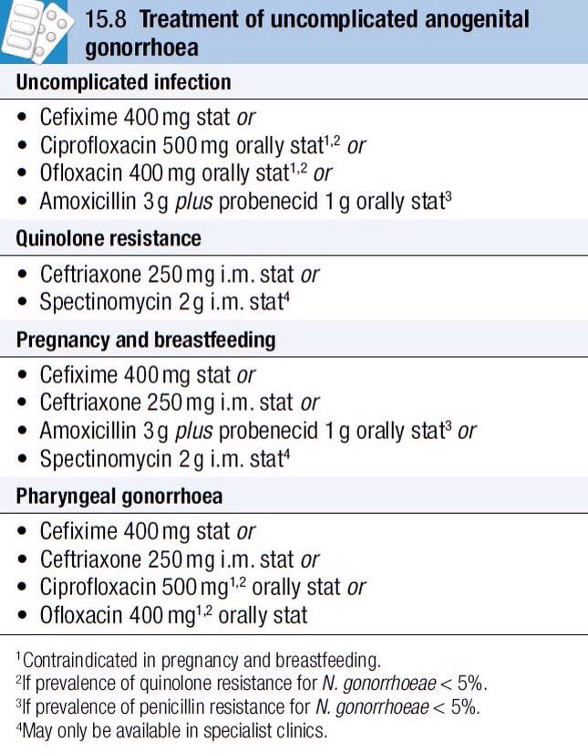
Management of adults:
Uncomplicated gonorrhoea responds to a single adequate dose of a suitable antimicrobial (many UK centres currently use oral cefixime 400 mg); cure rates should exceed 95%.

Slide 118
Longer courses of antibiotics are required for complicated infection.
Partner(s) of patients with gonorrhoea should be seen as soon as possible.
Delay in treatment may lead to complications.

Slide 119
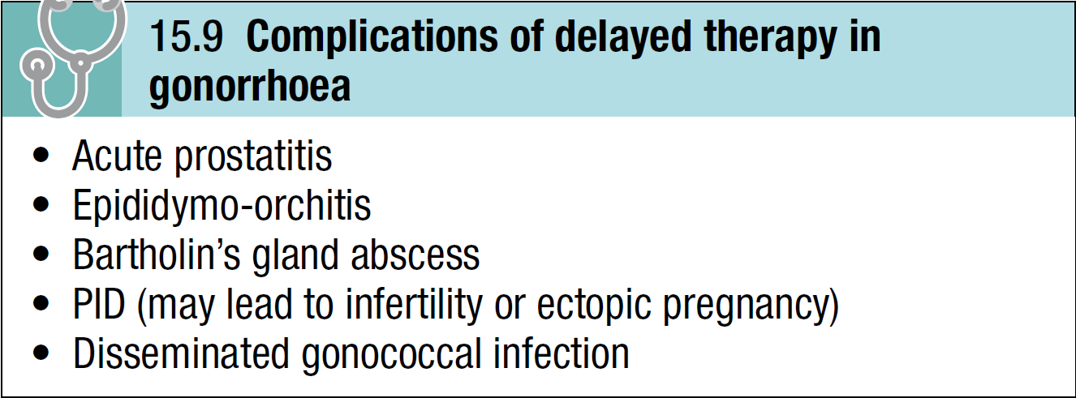

Slide 120
Chlamydial infection:
Chlamydial infection in men:
Chlamydia is transmitted and presents in a similar way to gonorrhoea; however, urethral symptoms are usually milder and may be absent in over 50% of cases.

Slide 121
Conjunctivitis is also milder than in gonorrhoea; pharyngitis does not occur.
The incubation period varies from 1 week to a few months.
Without treatment, symptoms may resolve but the patient remains infectious for several months.
Complications such as epididymo-orchitis and Reiter’s syndrome, or sexually acquired reactive arthropathy are rare.

Slide 122
Sexually transmitted pathogens such as chlamydia or gonococci are usually responsible for epididymo-orchitis in men aged less than 35 years, whereas bacteria such as Gram-negative enteric organisms are more commonly implicated in older men.

Slide 123
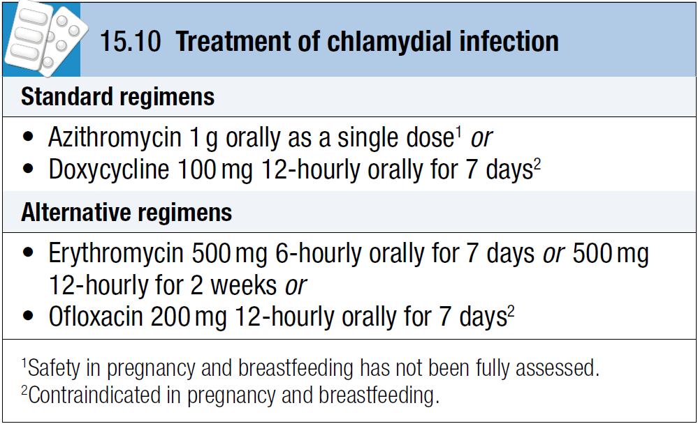

Slide 124
Non-specific urethritis is treated identically. The partner(s) of men with chlamydia should be treated even if laboratory tests for chlamydia are negative.
Investigation is not mandatory, but serves a useful epidemiological purpose; moreover, positive results encourage further attempts at contact-tracing.

Slide 125
Chlamydial infection in women:
The cervix and urethra are commonly involved.
Infection is asymptomatic in about 80% of patients but may cause vaginal discharge, dysuria, intermenstrual and/or postcoital bleeding.
Lower abdominal pain and dyspareunia are features of PID.

Slide 126
Examination may reveal mucopurulent cervicitis, contact bleeding from cervix, evidence of PID or no obvious clinical signs.
The patient’s male partner(s) should be investigated and treated.

Slide 127
Some infections may clear spontaneously but others persist.
PID, with the risk of tubal damage and subsequent infertility or ectopic pregnancy, is an important long-term complication.
Other complications include perihepatitis, chronic pelvic pain, conjunctivitis and Reiter’s syndrome or SARA.
Perinatal transmission may lead to ophthalmia neonatorum and/or pneumonia in the neonate.

Slide 128
Other sexually transmitted bacterial infections:
Chancroid, granuloma inguinale and LGV are causes of genital ulcers in the tropics.
LGV is also a cause of proctitis in MSM.

Slide 129
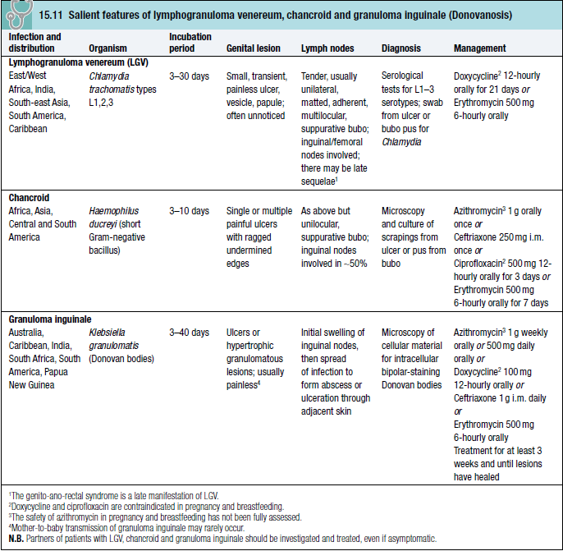

Slide 130
SEXUALLY TRANSMITTED VIRAL INFECTIONS:
Genital herpes simplex:
Infection with herpes simplex virus type 1 (HSV-1) or type 2 (HSV-2) produces a wide spectrum of clinical problems.
Transmission is usually sexual (vaginal, anal, orogenital or oroanal), but perinatal infection of the neonate may also occur.

Slide 131
Primary infection at the site of HSV entry, which may be symptomatic or asymptomatic, establishes latency in local sensory ganglia.
Recurrences, either symptomatic or asymptomatic viral shedding, are a consequence of HSV reactivation.
The first symptomatic episode is usually the most severe.

Slide 132
Although HSV-1 is classically associated with orolabial herpes and HSV-2 with anogenital herpes, HSV-1 now accounts for more than 50% of anogenital infections in the UK.

Slide 133
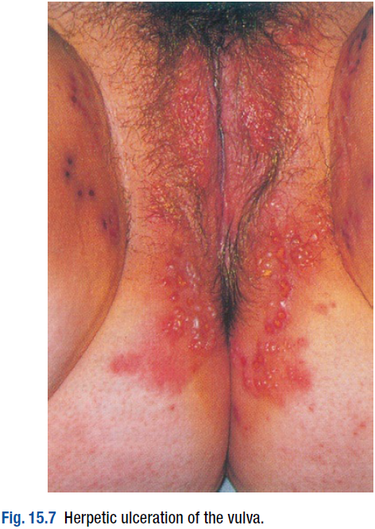
Clinical features:
The first symptomatic episode presents with irritable vesicles that soon rupture to form small, tender ulcers on the external genitalia.

Slide 134
Lesions at other sites (e.g. urethra, vagina, cervix, perianal area, anus or rectum) may cause dysuria, urethral or vaginal discharge, or anal, perianal or rectal pain.
Constitutional symptoms such as fever, headache and malaise are common.
Inguinal lymph nodes become enlarged and tender, and there may be nerve root pain in the 2nd and 3rd sacral dermatomes.

Slide 135
Extragenital lesions may develop at other sites such as the buttock, finger or eye due to auto-inoculation.
Oropharyngeal infection may result from orogenital sex.
Complications such as urinary retention due to autonomic neuropathy, and aseptic meningitis are occasionally seen.

Slide 136
First episodes usually heal within 2–4 weeks without treatment; recurrences are usually milder and of shorter duration than the initial attack. They occur more often in HSV-2 infection and their frequency tends to decrease with time.

Slide 137
Prodromal symptoms such as irritation or burning at the subsequent site of recurrence, or neuralgic pains affecting buttocks, legs or hips are commonly seen.
The first symptomatic episode may be a recurrence of a previously undiagnosed primary infection.
Recurrent episodes of asymptomatic viral shedding are important in the transmission of HSV.

Slide 138
Diagnosis:
Swabs are taken from vesicular fluid or ulcers for detection of DNA by PCR or tissue culture and typing.
Electron microscopy of such material will only give a presumptive diagnosis, as herpes group viruses appear similar.
Type-specific antibody tests are available but are not sufficiently accurate for general use.

Slide 139
Management:
First episode:
The following 5-day oral regimens are all recommended and should be started within 5 days of the beginning of the episode, or whilst lesions are still forming:
• aciclovir 200 mg five times daily
• famciclovir 250 mg 8-hourly
• valaciclovir 500 mg 12-hourly.

Slide 140
Analgesia may be required and saline bathing can be soothing.
Treatment may be continued for longer than 5 days if new lesions develop.
Occasionally intravenous therapy may be indicated if oral therapy is poorly tolerated or aseptic meningitis occurs.

Slide 141
Catheterisation via the suprapubic route is advisable for urinary retention due to autonomic neuropathy because the transurethral route may introduce HSV into the bladder.

Slide 142
Recurrent genital herpes:
Symptomatic recurrences are usually mild and may require no specific treatment other than saline bathing.
For more severe episodes patient-initiated treatment at onset, with one of the following 5-day oral regimens, should reduce the duration of the recurrence:
• aciclovir 200 mg five times daily
• famciclovir 125–150 mg 12-hourly
• valaciclovir 500 mg 12-hourly.

Slide 143
In a few patients, treatment started at the onset of prodromal symptoms may abort recurrence.

Slide 144
Suppressive therapy may be required for patients with frequent recurrences, especially if these occur at intervals of less than 4 weeks. Treatment should be given for a minimum of 1 year before stopping to assess recurrence rate.
About 20% of patients will experience reduced attack rates thereafter, but for those whose recurrences remain unchanged, resumption of suppressive therapy is justified. Aciclovir 400 mg 12-hourly is most commonly prescribed.

Slide 145
Management in pregnancy:
If her partner is known to be infected with HSV, a pregnant woman with no previous anogenital herpes should be advised to protect herself during sexual intercourse because the risk of disseminated infection is increased in pregnancy.
Consistent condom use during pregnancy may reduce transmission of HSV.

Slide 146
Genital herpes acquired during the first or second trimester of pregnancy is treated with aciclovir as clinically indicated.
Although aciclovir is not licensed for use in pregnancy in the UK, there is considerable clinical evidence to support its safety.
Third-trimester acquisition has been associated with life-threatening haematogenous dissemination and should be treated with aciclovir.

Slide 147
Vaginal delivery should be routine in women who are symptomless in late pregnancy.
Caesarean section (CS) is sometimes considered if there is a recurrence at the beginning of labour, although the risk of neonatal herpes through vaginal transmission is very low.
CS is often recommended if primary infection occurs after 34 weeks because the risk of viral shedding is very high in labour.

Slide 148
Human papillomavirus (HPV) and anogenital warts:
HPV DNA typing has demonstrated over 90 genotypes, of which HPV-6, HPV-11, HPV-16 and HPV-18 most commonly infect the genital tract through sexual transmission.
It is important to differentiate between the benign genotypes (HPV-6 and 11) that cause anogenital warts, and genotypes such as 16 and 18 that are associated with dysplastic conditions and cancers of the genital tract but are not a cause of benign warts.

Slide 149
All genotypes usually result in subclinical infection of the genital tract rather than clinically obvious lesions affecting penis, vulva, vagina, cervix, perineum or anus.

Slide 150
Clinical features:
Anogenital warts caused by HPV may be single or multiple, exophytic, papular or flat.
Perianal warts, whilst being more commonly found in MSM, are also found in heterosexual men and in women.
Rarely, a giant condyloma (Buschke–Lewenstein tumour) develops with local tissue destruction.

Slide 151
Atypical warts should be biopsied.
In pregnancy warts may dramatically increase in size and number, making treatment difficult. Rarely, they are large enough to obstruct labour and in this case delivery by CS will be required.
Perinatal transmission of HPV rarely leads to anogenital warts, or possibly laryngeal papillomas, in the neonate.

Slide 152
Management:
The use of condoms can help prevent the transmission of HPV to non-infected partners, but HPV may affect parts of the genital area not protected by condoms.
Vaccination against HPV infection has been introduced and is in routine use in several countries.

Slide 153
There are two types of vaccine:
A bivalent vaccine offers protection against HPV types 16 and 18, which account for approximately 75% of cervical cancers in the UK.
A quadrivalent vaccine offers additional protection against HPV types 6 and 11, which account for over 90% of genital warts.

Slide 154
Both types of vaccine have been shown to be highly effective in the prevention of cervical intraepithelial neoplasia in young women, and the quadrivalent vaccine has also been shown to be highly effective in protecting against HPV-associated genital warts.

Slide 155
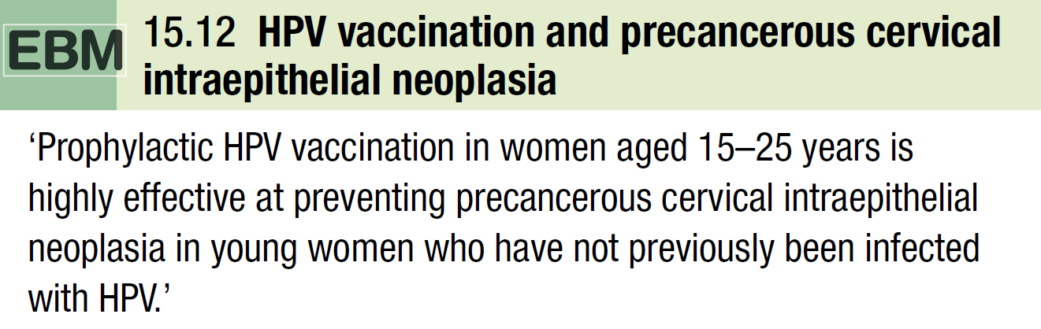

Slide 156
It is currently recommended that HPV vaccination should be administered prior to the onset of sexual activity, typically at age 11–13, in a course of three injections.
In the UK, only girls are being offered vaccination, although it should be noted that this approach will not protect HPV transmission for MSM.
As neither vaccine protects against all oncogenic types of HPV, cervical screening programmes will still be necessary.

Slide 157
A variety of treatments are available for established disease, including the following:
a. Podophyllotoxin, 0.5% solution or 0.15% cream (contraindicated in pregnancy) applied 12-hourly for 3 days, followed by 4 days’ rest, for up to 4 weeks is suitable for home treatment of external warts.

Slide 158
b. Imiquimod cream (contraindicated in pregnancy) applied 3 times weekly (and washed off after 6–10 hours) for up to 16 weeks is also suitable for home treatment of external warts.
c. Cryotherapy using liquid nitrogen to freeze warty tissue is suitable for external and internal warts but often requires repeated clinic visits.

Slide 159
d. Hyfrecation—electrofulguration that causes superficial charring—is suitable for external and internal warts. Hyfrecation results in smoke plume which contains HPV DNA and the potential to cause respiratory infection in the operator/patient. Masks should be worn during the procedure and adequate extraction of fumes should be provided.

Slide 160
e. Surgical removal: Refractory warts, especially pedunculated perianal lesions, may be excised under local or general anaesthesia.

Slide 161
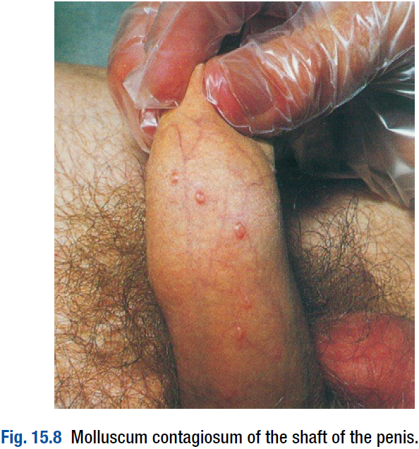
Molluscum contagiosum:
Infection by molluscum contagiosum virus, both sexual and non-sexual, produces flesh-coloured umbilicated hemispherical papules usually up to 5 mm in diameter after an incubation period of 3–12 weeks.

Slide 162
Larger lesions may be seen in HIV infection.
Lesions are often multiple and, once established in an individual, may spread by auto-inoculation.
They are found on the genitalia, lower abdomen and upper thighs when sexually acquired.
Facial lesions are highly suggestive of underlying HIV infection.

Slide 163
Diagnosis is made on clinical grounds and by expression of the central core, in which the typical pox-like viral particles can be seen on electron microscopy (differentiating molluscum contagiosum from genital warts).

Slide 164
Typically, lesions persist for an average of 2 years before spontaneous resolution occurs.
Treatment regimens are therefore cosmetic; they include cryotherapy, hyfrecation, topical applications of 0.15% podophyllotoxin cream (contraindicated in pregnancy) or expression of the central core.

Slide 165
Viral hepatitis:
The hepatitis viruses A–D may be sexually transmitted:
• Hepatitis A (HAV): Insertive oroanal sex, insertive digital sex, insertive anal sex and multiple sexual partners have been linked with HAV transmission in MSM. HAV transmission in heterosexual men and women is also possible through oroanal sex.

Slide 166
• Hepatitis B (HBV): Insertive oroanal sex, anal sex and multiple sexual partners are linked with HBV infection in MSM. Heterosexual transmission of HBV is well documented and commercial sex workers are at particular risk. Hepatitis D (HDV) may also be sexually transmitted.

Slide 167
• Hepatitis C: Sexual transmission of HCV is well documented in MSM, but less so in heterosexuals. Sexual transmission is less efficient than for HBV.

Slide 168
The sexual partner(s) of patients with HAV and HBV should be seen as soon as possible and offered immunisation where appropriate.
Patients with HAV should abstain from all forms of unprotected sex until non-infectious.
Those with HBV should likewise abstain from unprotected sex until they are non-infectious or until their partners have been vaccinated successfully.

Slide 169
No active or passive immunisation is available for protection against HCV but the consistent use of condoms is likely to protect susceptible partners.
Active immunisation against HAV and HBV should be offered to susceptible people at risk of infection.
Many STI clinics offer HAV immunisation to MSM along with routine HBV immunisation; a combined HAV and HBV vaccine is available.

Slide 170
end

